Slide 1
Red team Nurlan Yagublu Siyu Chen Nazrin Ibadli Fei Wang Zebai Tian
Log Analysis 1
Demo 2
23/04/2024

Slide 2
Sprint review
Sprint time: 2 Apr – 23 Apr
Total Tasks: 15
Done: 12
In progress: 3
Sprint main goal: Optimization of the analysis and structured log extraction

Slide 3
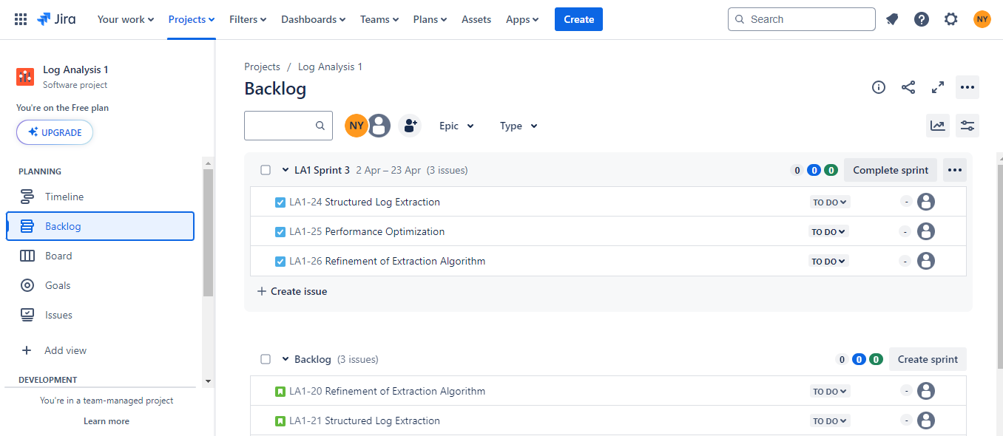
Sprint planning

Slide 4
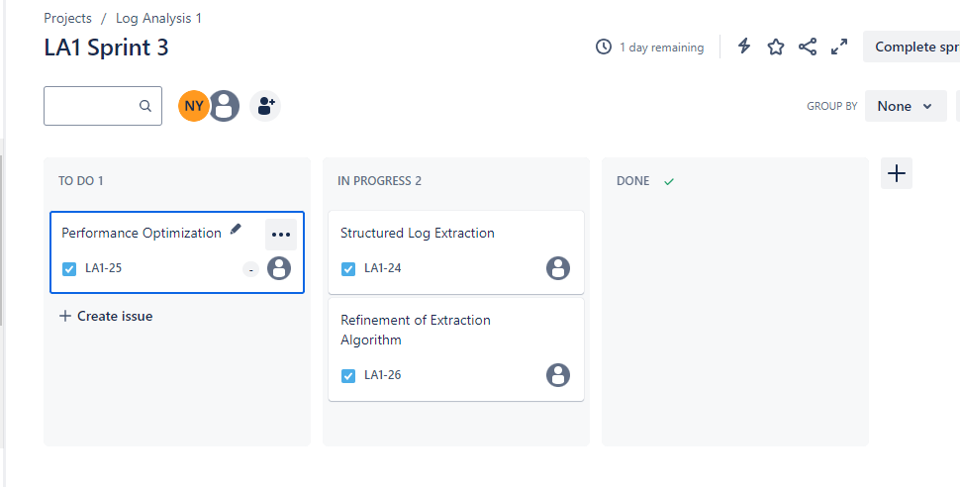

Slide 5
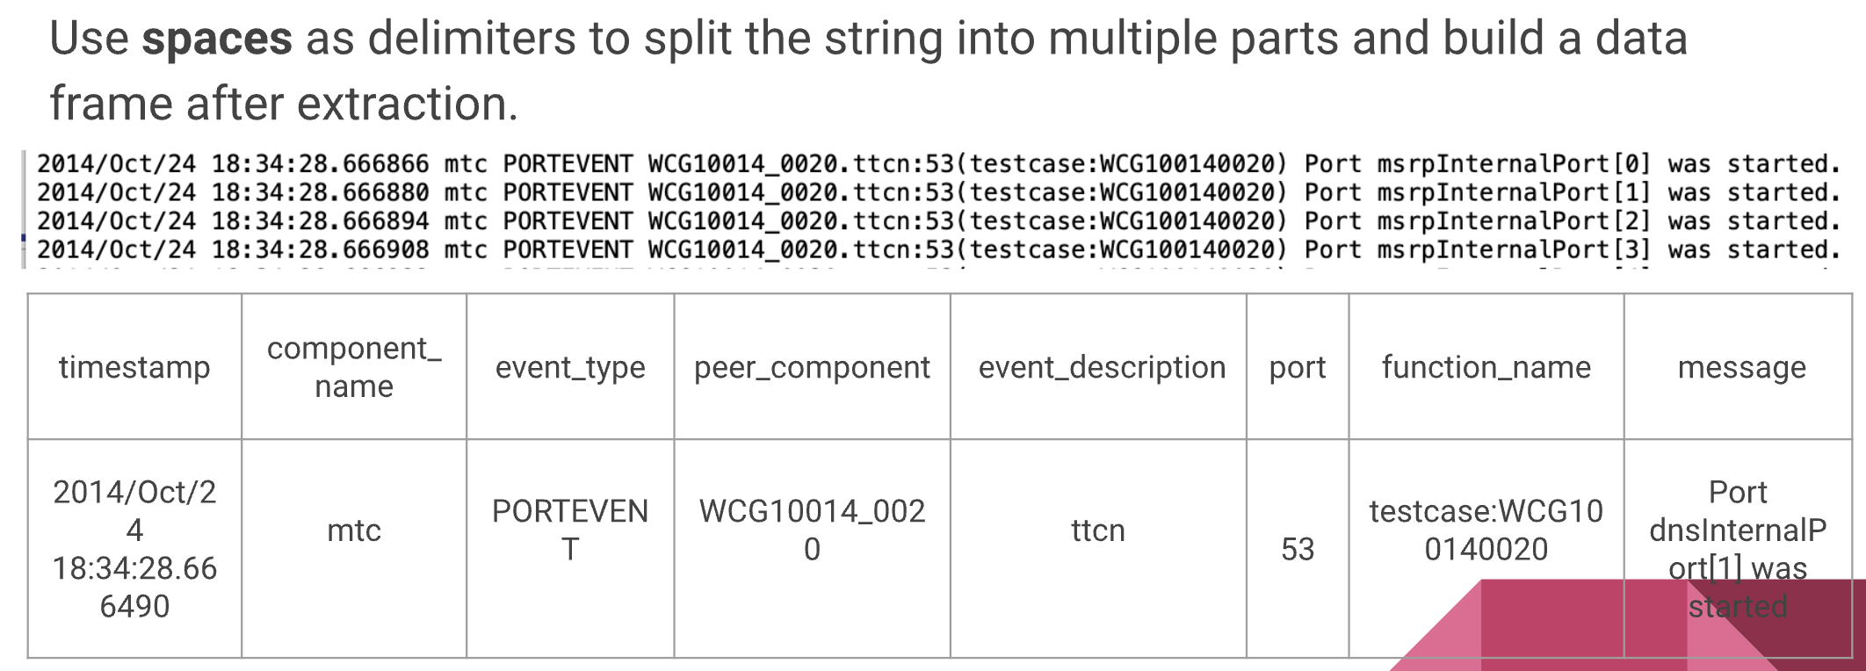
single value extraction

Slide 6
Multiple value extraction
Step 1: Determine if the message body contains structured data by checking for the presence of curly braces ‘{}’.
Step 2: Create a stack structure to determine if all types of brackets are closed.
Step 3: Convert custom data structures to JSON types according to JSON syntax rules.
Step 4: Recursively parse JSON strings based on hierarchy.

Slide 7
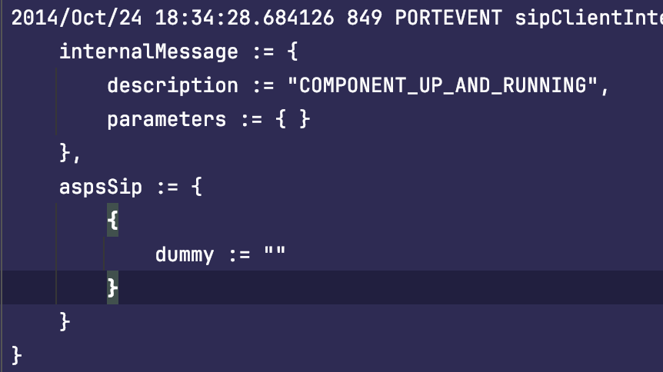
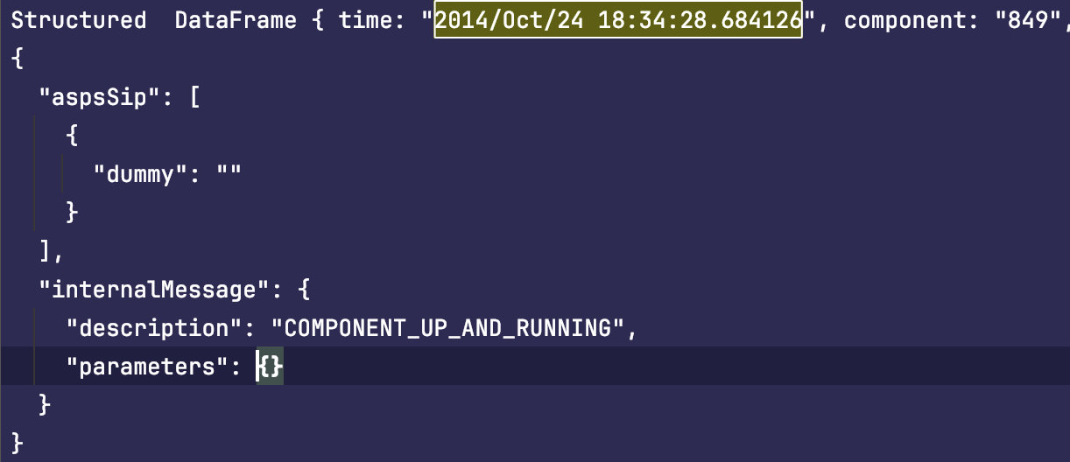
Refinement of extraction algorithm
ORIGINAL FORMAT
JSON FORMAT

Slide 8
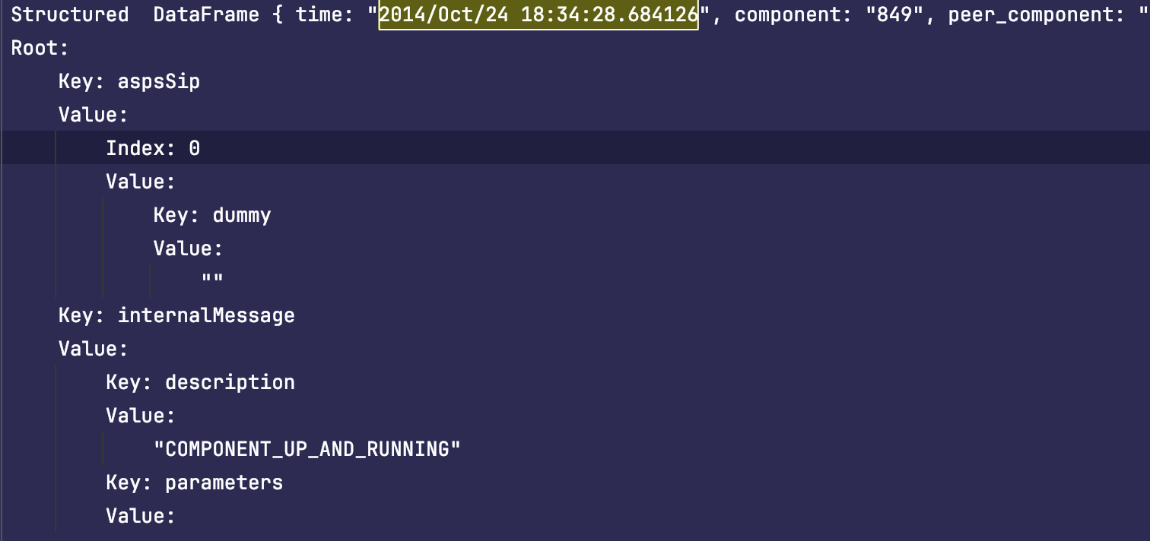
Refinement of extraction algorithm
Final FORMAT

Slide 9
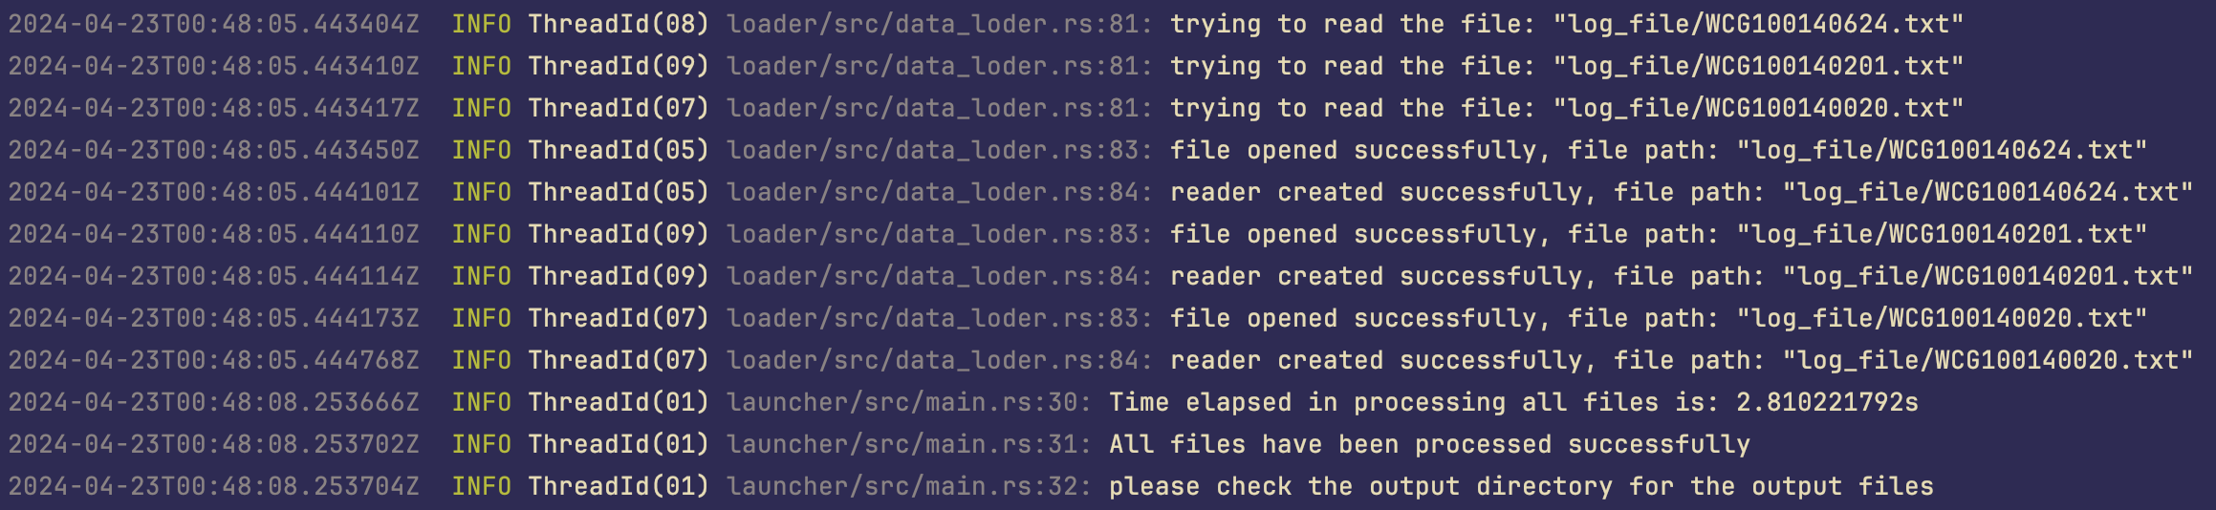
Performance optimization
Analyzing file read times, concurrent processing threads, and overall processing times through log records.
The time elapsed in processing all files is: 2.810221792 seconds.
Notes:
异步处理asy mutil thread

Slide 10
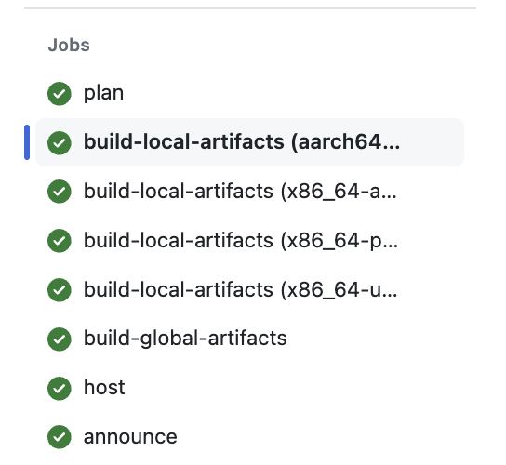
CI/CD
We use GitHub Actions as our CI/CD tool. When we create a new release tag, it clones the codebase, compiles it for multiple platforms (Windows, Linux, MacOS), computes checksums, and then automatically uploads it to GitHub.

Slide 11
CI/CD
Plan: This phase plans the release, checks Git tags, builds a release plan, and exports it as a JSON manifest.
Build-Local-Artifacts: This phase builds local (platform-specific) artifacts like binaries and installers and packages them into ZIP files based on the release plan.
Build-Global-Artifacts: Similar to the previous phase but builds global (platform-independent) artifacts like universal installers and packages them into ZIP files.
Host: This phase uploads the build artifacts to temporary storage on GitHub’s release page, preparing them for the final release step.
Announce: This phase publishes the release on GitHub, and uses GitHub’s API to create and upload the release to the release page.

Slide 12
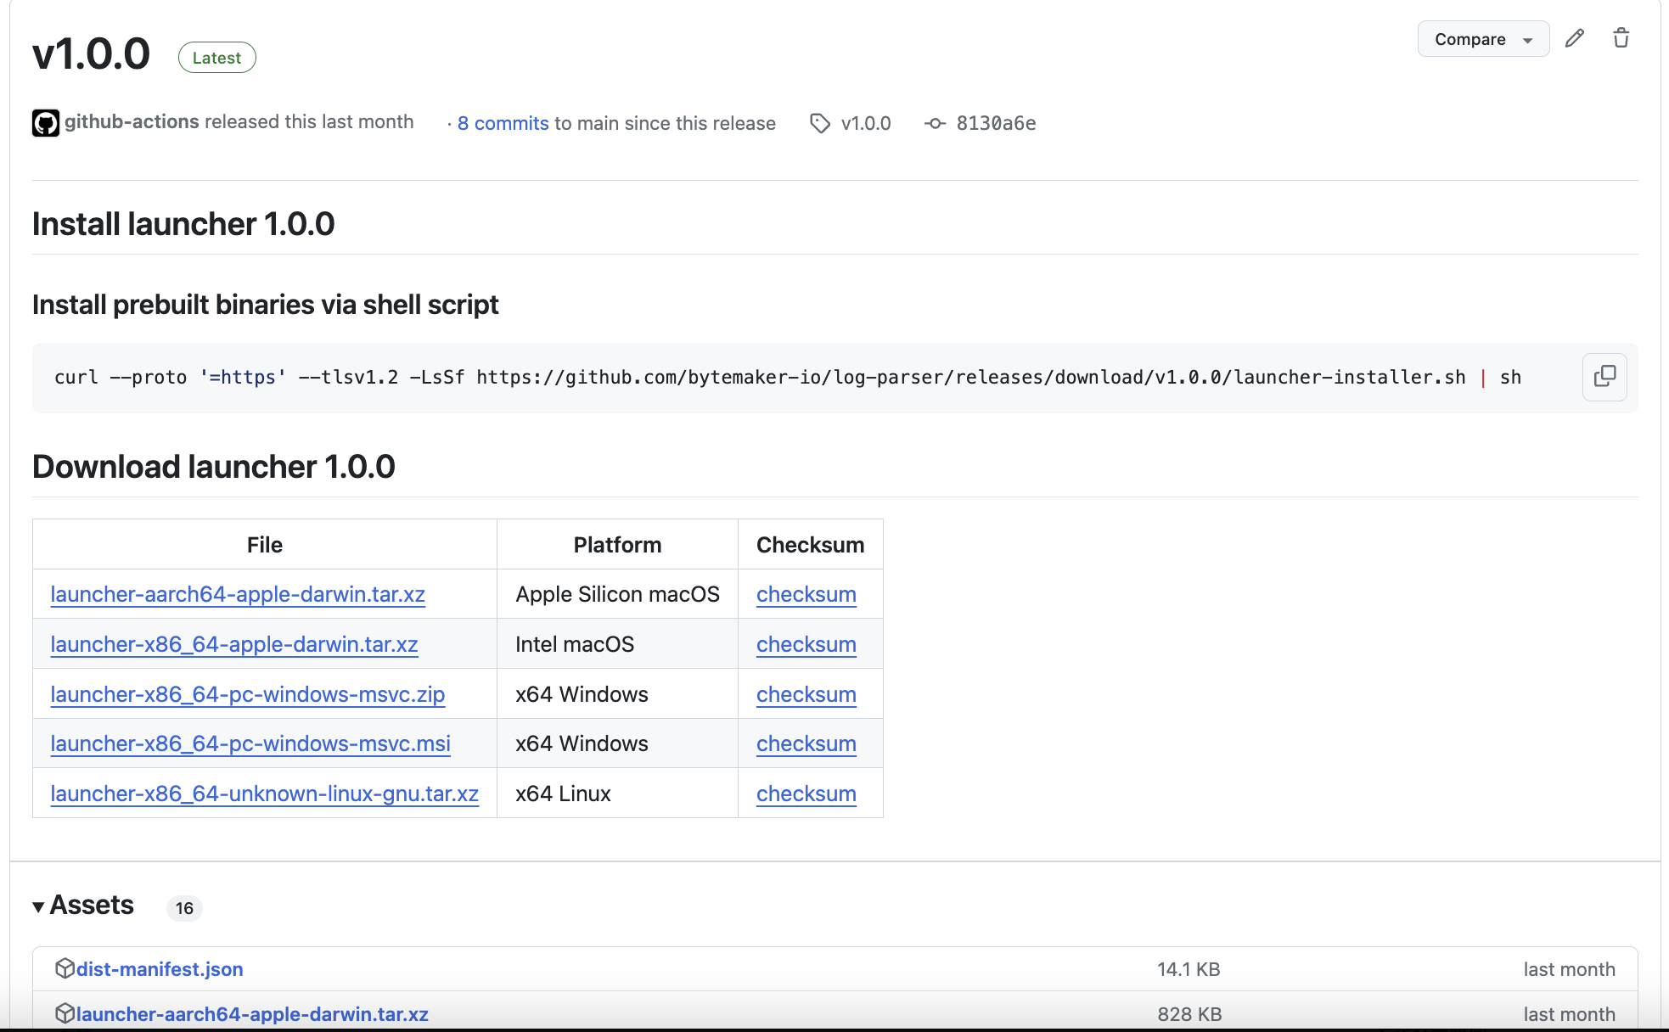
CI/CD

Slide 13
Thank you

